Slide 1
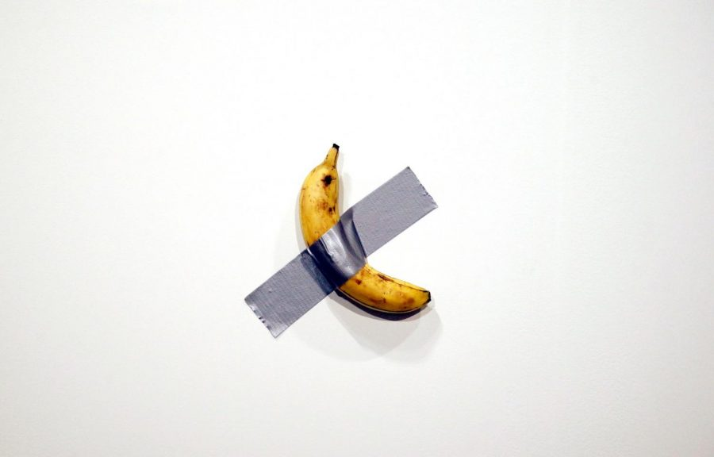
The influence of postmodernism on animation

Slide 2
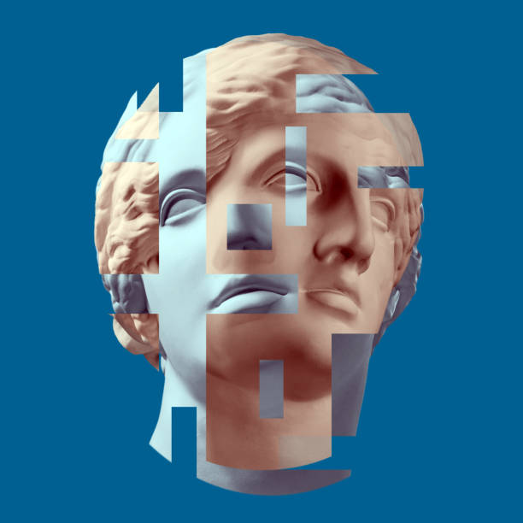
Contents
Introduction
Post-modernism and animation
Stylised ways of representing postmodernism in animation
Conclusion

Slide 3
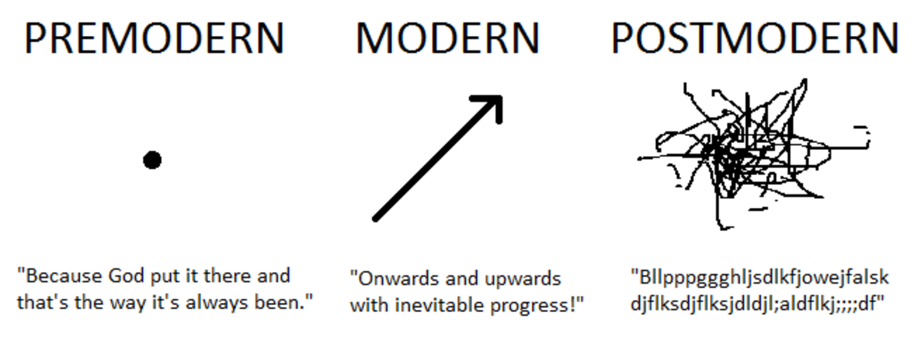
People tend to decide on their own ideas and interpretations according to their own wishes.

Slide 4
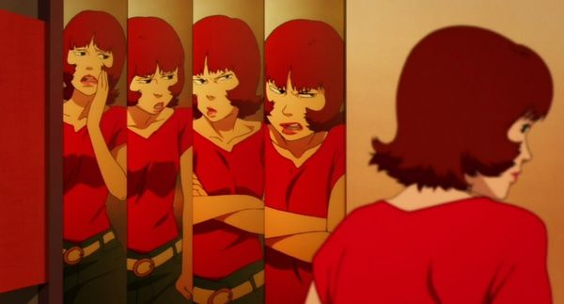
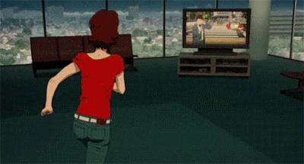
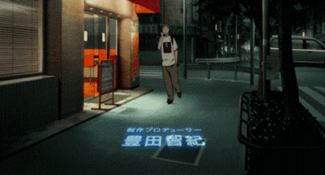
Paprika

Slide 5
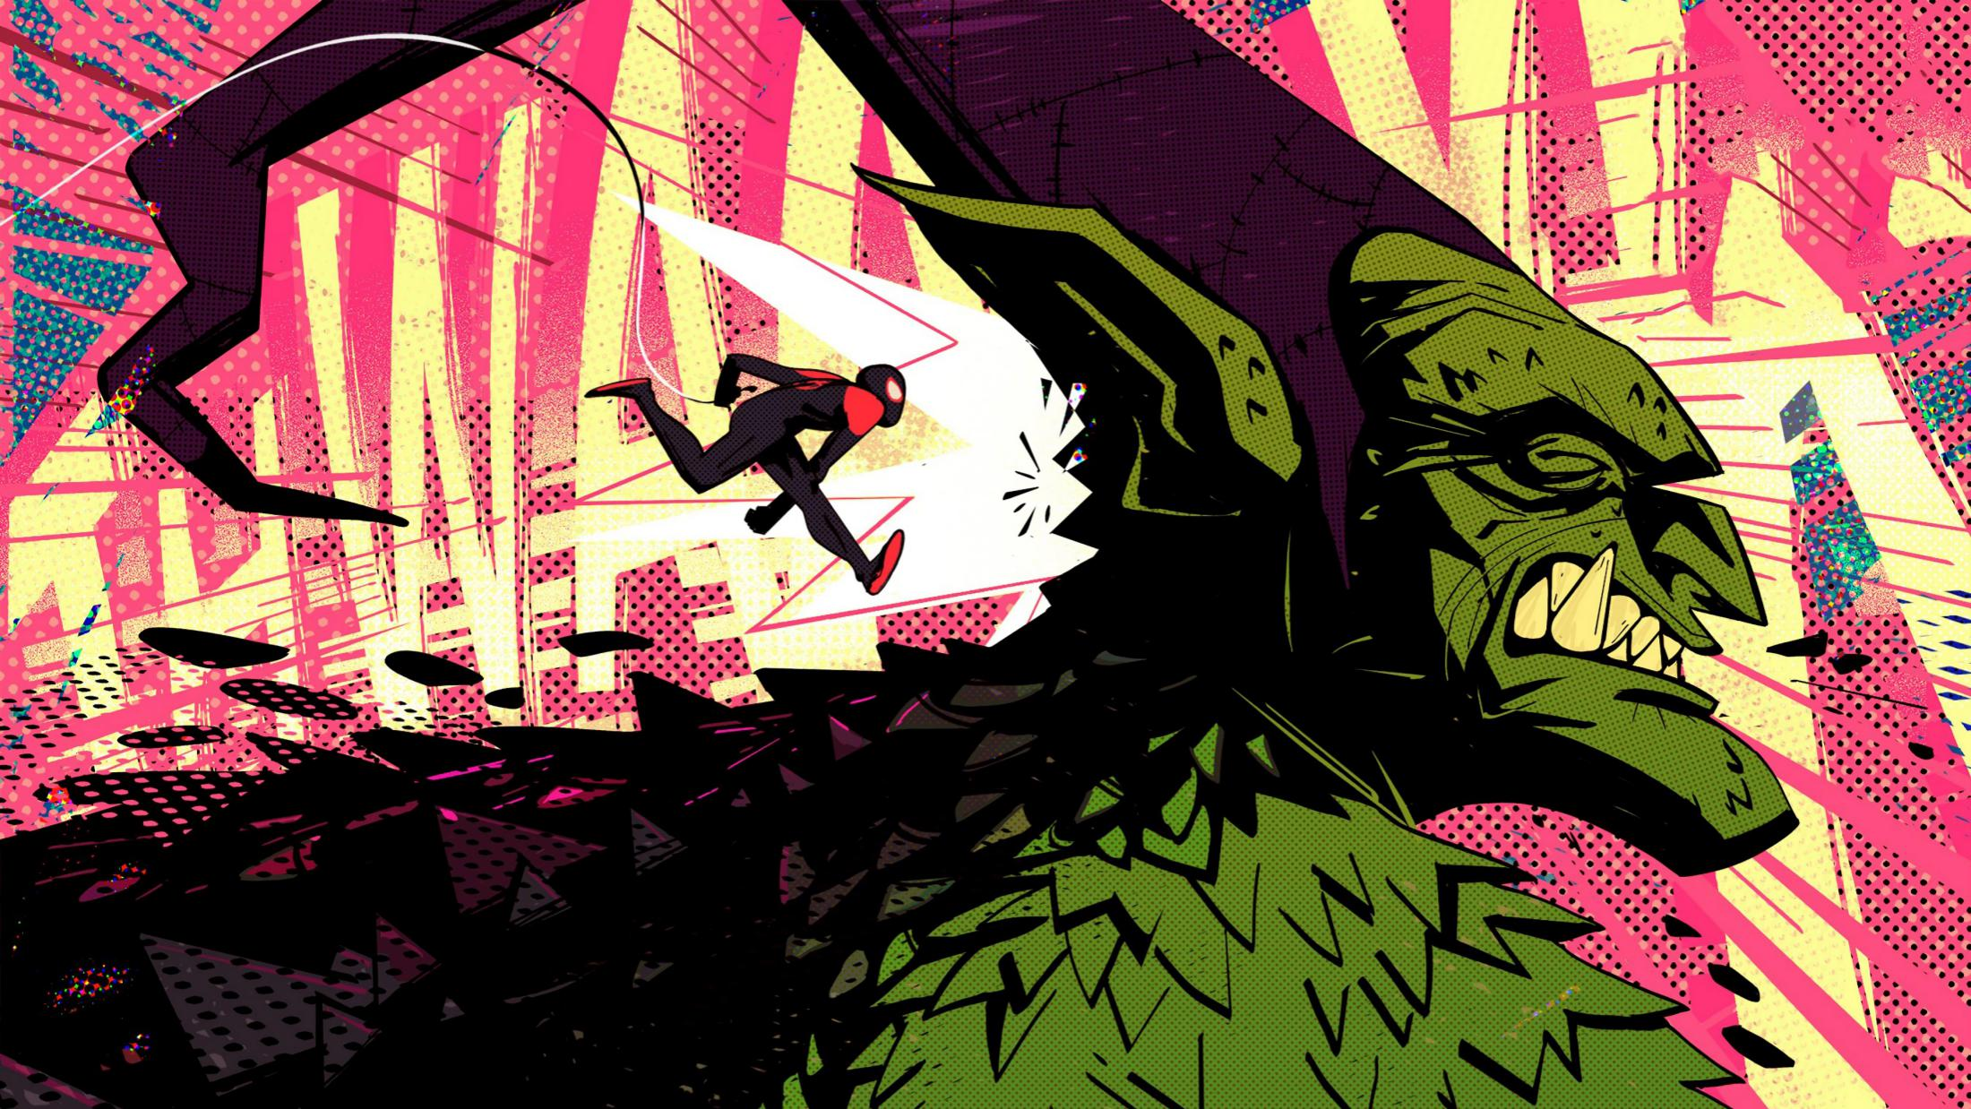
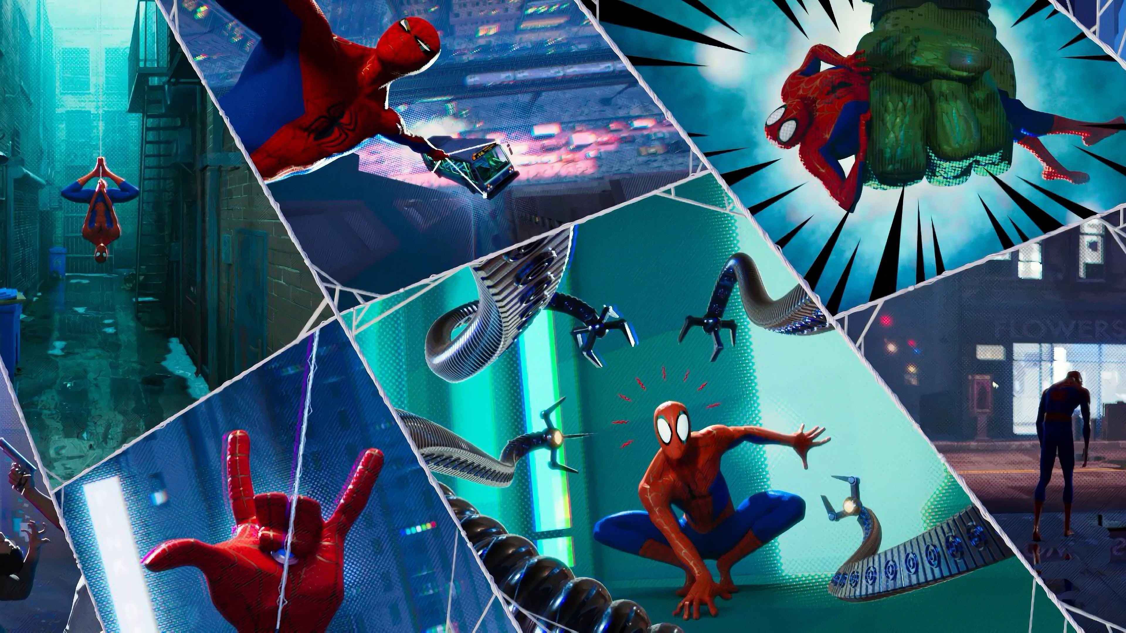
Spider-Man in to the spider Universe

Slide 6
Thank you for watching

